Slide 1
Overview of Windows Internals
A Peek into Fundamentals and Internal Design

Slide 2
Windows System Architecture Agenda
PART I
OneCore Kernel
Windows API
Services, functions, and routines
Virtual Memory
Kernel Mode vs User Mode
Registry
Scheduling
PART II
Drivers
Drivers Characteristics
Drivers on Windows
Driver Architecture

Slide 3
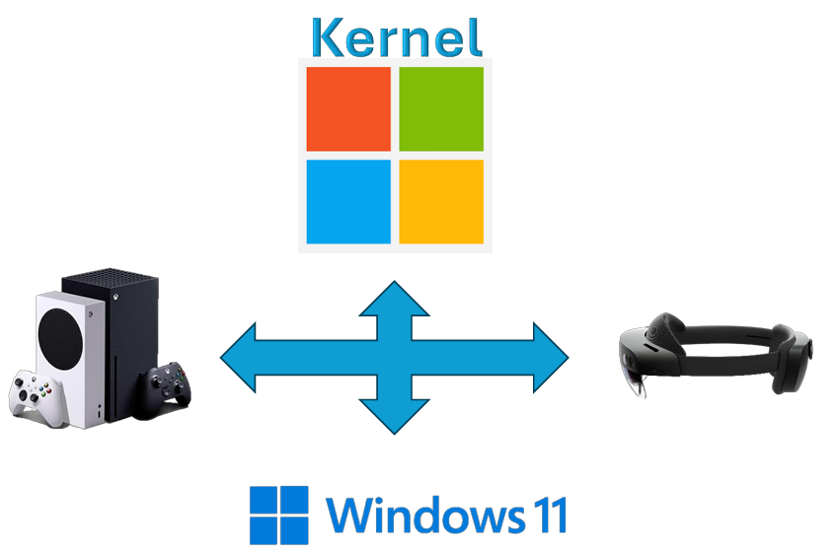
OneCore Kernel
Convergence of kernels and base platforms into a single core.
Runs on a variety of devices. They share the same kernel, drivers, and base platform binaries.

Slide 4
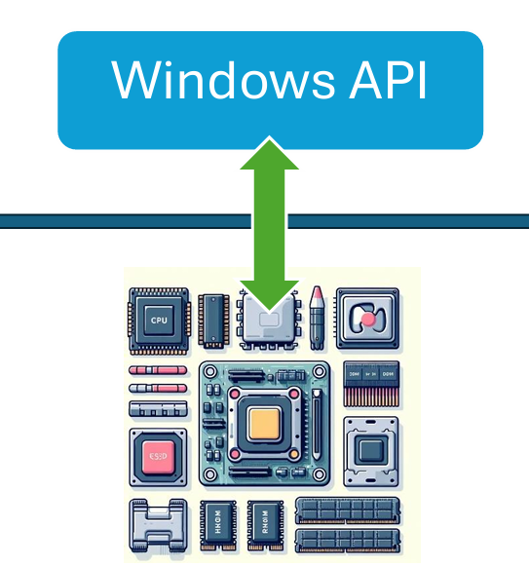
Windows API (Windows Application Programming Interface)
User Mode Application Programming Interface for the Windows family of operating systems.
Some Tasks:
File Access
Memory management
Input/Output operations
Interaction with hardware devices

Slide 5
Services, functions, and routines
Windows API functions
Dynamic link Libraries
System Calls
Routines
Windows services

Slide 6
Services, functions, and routines
Windows API functions
System Calls
Documented and callable subroutines
Callable from user mode
Examples:
CreateProcess
CreateFile
GetMessage
SendMessage
Examples:
NTCreateUserProcess
NTCreateFile
NTOpenFile

Slide 7

Services, functions, and routines
Kernel support functions (routines)
Windows Services
Callable only from kernel mode
Elevated privileges
Direct access to hardware
Runs in the background
Example:
Windows Update Service
Dynamic Link Libraries (DLLs)
Allow code sharing between applications
Only one copy of a DLL’s code is loaded in memory

Slide 8
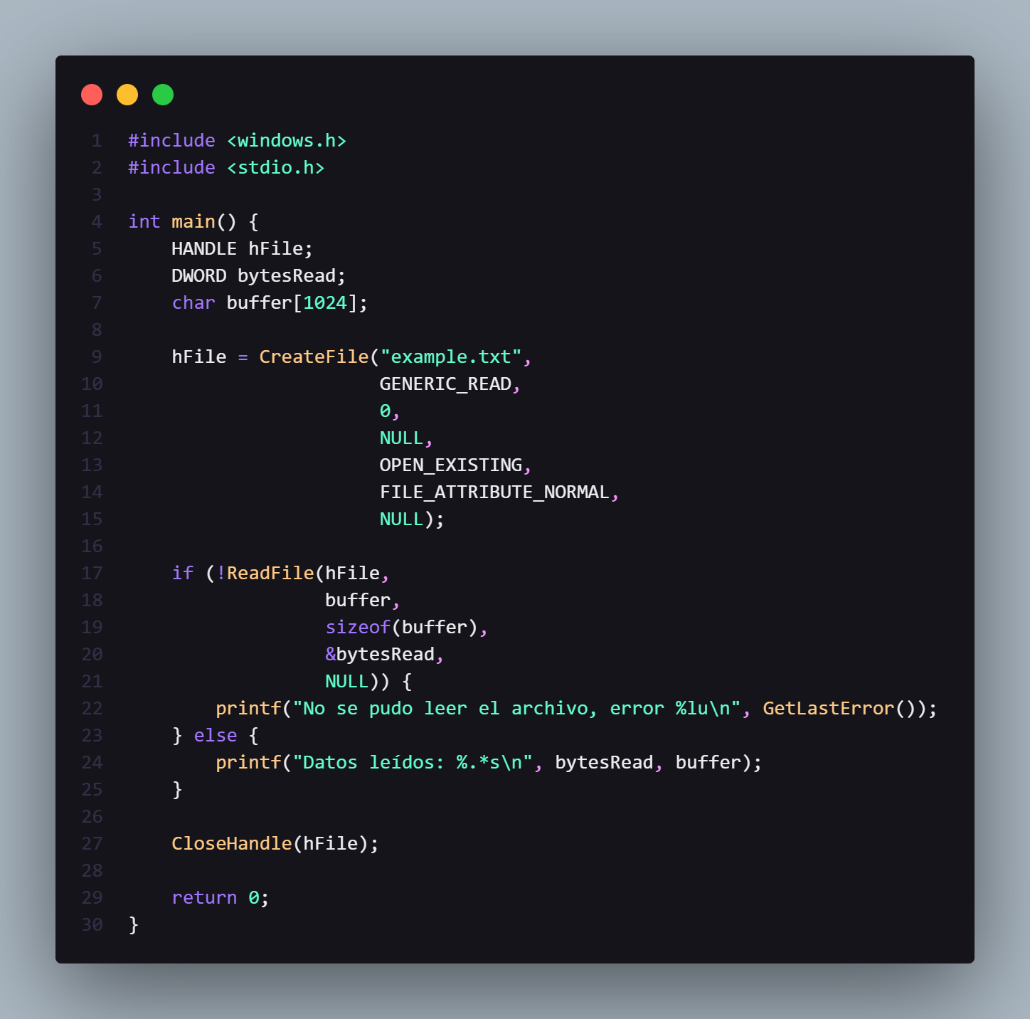
Example: ReadFile function (fileapi.h)

Slide 9
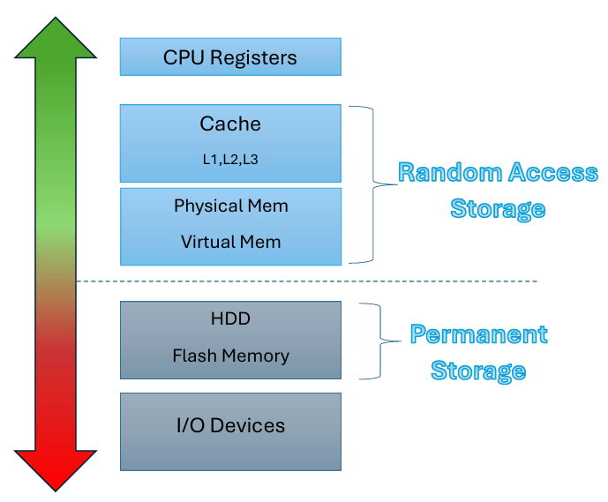
Memory
Physical organization of Memory

Slide 10
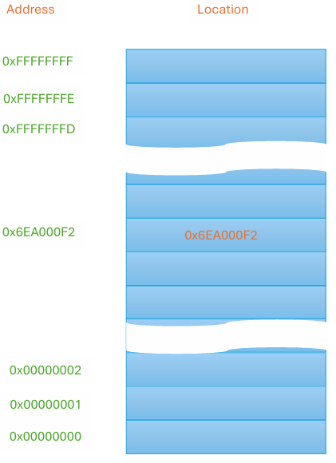
Memory
The interaction is achieved through a set of reads and writes to specific address performed by the processes.
Address Vector
Volatility
Shared by CPU and I/O devices

Slide 11

How does the Operating System manage resources when they are no longer sufficient to meet the demand?

Slide 12
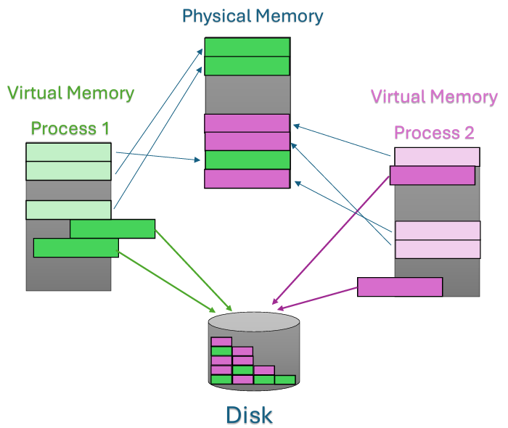
Virtual Memory
Its main role is to give each process the illusion of having its own large and private memory address space.
VM works as follows:
Virtual Address Spaces
Address Translation
Paging
Protection and Mapping
Data Relocation

Slide 13
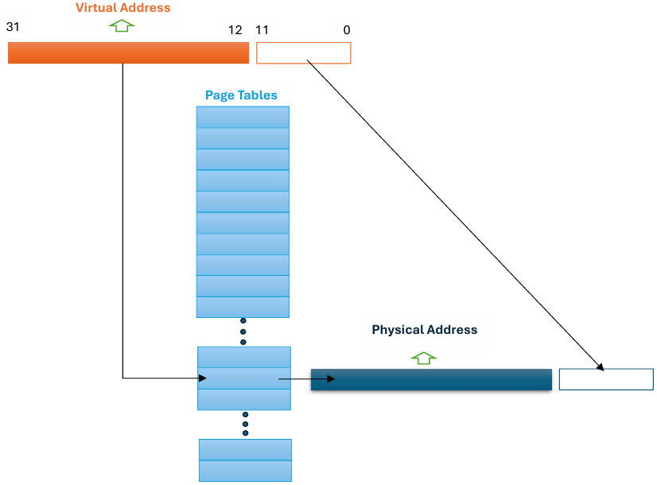
Memory Translation

Slide 14
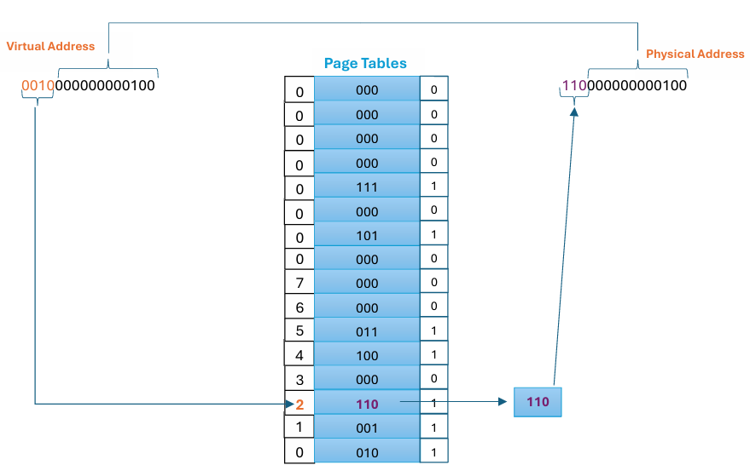
Memory Translation
Virtual incoming address: 8196
Outgoing physical address: 24580

Slide 15
Kernel Mode and User Mode
In The Windows operating system, there are two execution modes:
User Mode
Kernel Mode
Applications have limited access to system resources.
User application code operates in this mode.
Restrictions in this mode prevent unauthorized modifications.
There is full access to all system resources.
The operating system has elevated privileges and can perform critical operations.
Operating system code such as device drivers.

Slide 16
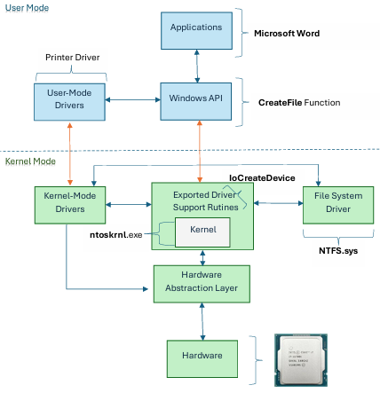
Communication: User mode and Kernel mode

Slide 17
Windows: Kernel Mode
The OS code and device drivers share a unified virtual
address space.
Pages in the system space
are accessible
f
Kernel Mode
Driver Signing
Windows 10 and 11
Components must be
meticulously designed and tested

Slide 18
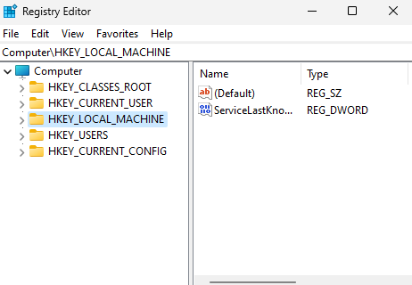
Registry
The registry centralizes the information necessary for the proper functioning of Windows OS.
Stores necessary information:
System Boot
System Configuration
User Preferences
Security Management
Current hardware status

Slide 19
Scheduling
Scheduling manages multitasking by determining which threads receive the next time slice from the CPU.
The main goal is to keep the CPU as busy as possible to maximize CPU utilization.
Ensures that the limited CPU resources are used efficiently.

Slide 20
CPU Scheduler
The CPU scheduler is responsible for selecting which process to execute when the CPU is idle.
CPU Scheduling
Preemptive
Non-preemptive

Slide 21
CPU-Scheduling decisions
Transition from:
Running -> waiting state
Running -> ready state
Waiting -> ready state
When a process terminates
Non-preemptive
Preemptive
Preemptive
Non-preemptive

Slide 22
Windows Scheduling
Scheduling Algorithm: Preemptive Priority-Based
Windows Dispatcher:
Responsible for thread scheduling.
Ensures that the highest priority always runs.
Execution Criteria:
Thread priority
Thread completion
Time quantum expiration
Blocking system call I/O
Priorities:
Variable Class: Priorities from 1 to 15
Real-Time Class: Priorities from 16 to 31
Priority 0: For memory management
Priority Scheme:
32 priority levels
Uses a queue for each priority level
Traverses the queues from highest to lowest priority to find the next ready thread.

Slide 23
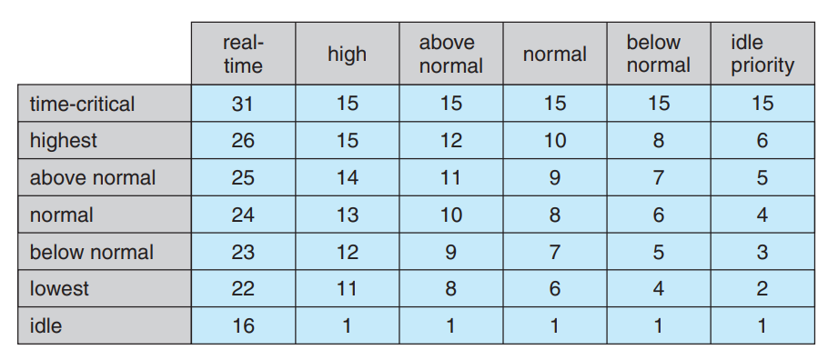
Windows Thread Priorities
Source: Silberschatz, A., Galvin, P.B., & Gagne, G. Operating System Concepts

Slide 24
What is a Driver?
A driver is a software component designed to facilitate communication between applications and hardware devices.
Drivers detect, initialize, and manage hardware devices, allowing applications and the Operating System to send commands and receive data from the device.

Slide 25
Characteristics of Drivers
Run in the Background
Direct Communication in Kernel Mode
Response to I/O Requests
Lifespan Correspondence

Slide 26
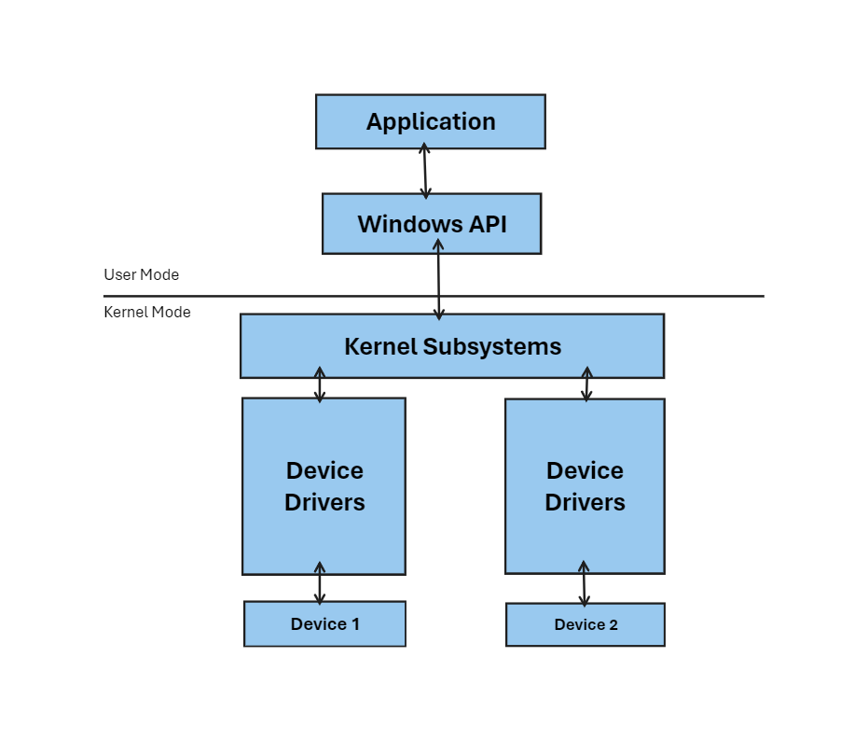
How do drivers fit into the Windows OS?
Drivers have an interface between the device and the Kernel Subsystems. This interface facilitates communications and interaction between the device’s hardware and the OS software.

Slide 27
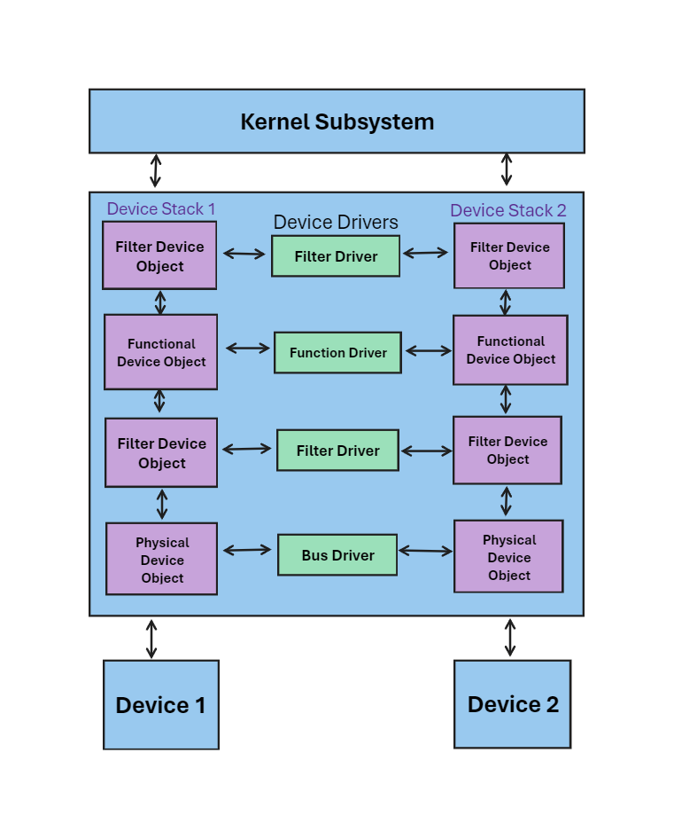
Driver Architecture
Key Points:
Modular Layered Architecture
Packet-bases I/O
Asynchronous I/O
Dynamic Loading and Unloading
Device Object:
Acts as a participation indicator, informing the system of involvement in request processing.
Associated with each driver handling device-related requests.
Device Stack:
Each device has it own stack.
Organized collection of Device Objects

Slide 28
Overview of Windows Internals
A Peek into Fundamentals and Internal Design

